Slide 1
CSC 223
DATA AND SIGNALS

Slide 2
Data and Signals
One of the major functions of the physical layer is to move data in the form of electromagnetic signals across a transmission medium.
Whether you are sending animated pictures from a design workstation, or causing a bell to ring at a distant control center, you are working with the transmission of data across network connections.

Slide 3
Generally, the data usable to a person or application are not in a form that can be transmitted over a network.
For example, a photograph must first be changed to a form that transmission media can accept.
Transmission media work by conducting energy along a physical path.
To be transmitted, data must be transformed to electromagnetic signals.

Slide 4
ANALOG AND DIGITAL
Both data and the signals that represent them can be either analog or digital in form.

Slide 5
Data can be analog or digital.
The term analog data refers to information that is continuous;
Analog data is a continuous representation, analogous to the actual information it represents
For example, an analog clock that has hour, minute, and second hands gives information in a continuous form; the movements of the hands are continuous.
In example, a mercury thermometer is an analog device. The mercury rises in a continuous flow in the tube in direct proportion to the temperature.

Slide 6
Analog data, such as the sounds made by a human voice, take on continuous values.
When someone speaks, an analog wave is created in the air. This can be captured by a microphone and converted to an analog signal or sampled and converted to a digital signal.

Slide 7
Digital data refers to information that has discrete states.
Digital data is a discrete representation, breaking the information up into separate (discrete) elements.
A digital clock that reports the hours and the minutes will change suddenly from 8:05 to 8:06.
Computers can’t work with analog information, so a need do digitize the analog information arise. This is done by breaking the analog information into pieces and representing those pieces using binary digits

Slide 8
Digital data take on discrete values.
For example, data are stored in computer memory in the form of Os and 1s. They can be converted to a digital signal or modulated into an analog signal for transmission across a medium.

Slide 9
The most familiar “analog” communication is a phone call. Varying electrical voltage reflects the variations in the volume and tone of the human voice.
By contrast, digital communications use a series of 1s and 0s to carry information from point to point.
Modems actually convert the digital data of one computer into an analog signal for transmission over the phone lines. On the receiving end, another modem converts the analog signal back into a series of 1s and 0s, so the receiving computer can interpret the transmission

Slide 10
Both electronic signals (analog and digital) degrade as they move down a line. The voltage of the signal fluctuates due to environmental effects.
When it comes to moving data, digital communications are less susceptible to errors and faster than analog signals because they are not susceptible to problems such as electrical “noise” on transmission lines.

Slide 11
As soon as an analog signal degrades, information is lost. Since any voltage level within the range is valid, it is impossible to know that the original signal was even changed
Digital signals jump sharply between two extremes (high and low state).
A digital signal can degrade quite a bit until the information is lost, because any value over a certain threshold is considered high value and bellow the threshold is considered low value

Slide 12
You can still retrieve the information from a reasonably degraded digital signal
Periodically a digital signal is reclocked to regain its original shape.
As long as it is reclocked before too much degradation, no info is lost

Slide 13
Digital & Analog signals

Slide 14
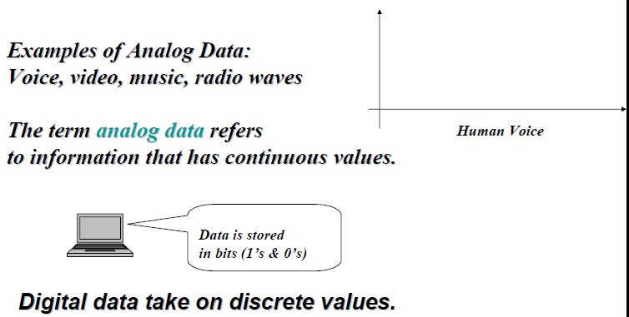

Slide 15
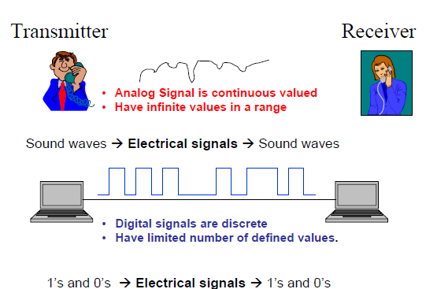
Signal is a vehicle for carrying data

Slide 16
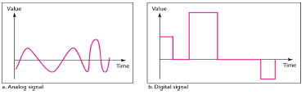
Comparison of analog and digital
The simplest way to show signals is by plotting them on a pair of perpendicular axes. The vertical axis represents the value or strength of a signal. The horizontal axis represents time.

Slide 17
Periodic & Non periodic signals
Both analog and digital signals can take one of two forms: periodic or nonperiodic (sometimes refer to as aperiodic, because the prefix a in Greek means "non").

Slide 18
Periodic signal
A periodic signal completes a pattern within a measurable time frame, called a period, and repeats that pattern over subsequent identical periods.
The completion of one full pattern is called a cycle.

Slide 19
Nonperiodic (Aperiodic) signal
A nonperiodic signal changes without exhibiting a pattern or cycle that repeats over time.
Both analog and digital signals can be periodic or nonperiodic.
In data communications, we commonly use periodic analog signals (because they need less bandwidth) and nonperiodic digital signals (because they can represent variation in data)

Slide 21
Periodic analog
Periodic analog signals can be classified as simple or composite.
A simple periodic analog signal, a sine wave, cannot be decomposed into simpler signals.
A composite periodic analog signal is composed of multiple sine waves.

Slide 22
Sine wave
The sine wave is the most fundamental form of a periodic analog signal.
When we visualize it as a simple oscillating curve, its change over the course of a cycle is smooth and consistent, a continuous, rolling flow.

Slide 23
Peak Amplitude
The peak amplitude of a signal is the absolute value of its highest intensity, proportional to the energy it carries.
For electric signals, peak amplitude is normally measured in volts.

Slide 24
Period and Frequency
Period refers to the amount of time, in seconds, a signal needs to complete 1 cycle.
Frequency is the number of periods in I sec.
Note that period and frequency are just one characteristic defined in two ways.
Period is the inverse of frequency, and frequency is the inverse of period, as the following formulas show.
f= 1/T and T=1/f

Slide 25
Period is formally expressed in seconds. Frequency is formally expressed in Hertz (Hz), which is cycle per second.
Unit | Equivalent | Unit | Equivalent
Seconds (s) | 1 s | Hertz (Hz) | 1 Hz
Milliseconds (ms) | 10⁻³ s | Kilohertz (kHz) | 10³ Hz
Microseconds (µs) | 10⁻⁶ s | Megahertz (MHz) | 10⁶ Hz
Nanoseconds (ns) | 10⁻⁹ s | Gigahertz (GHz) | 10⁹ Hz
Picoseconds (ps) | 10⁻¹² s | Terahertz (THz) | 10¹² Hz

Slide 26
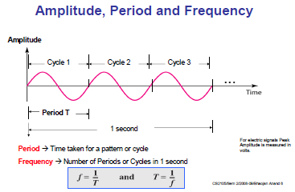

Slide 27
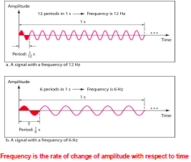

Slide 28
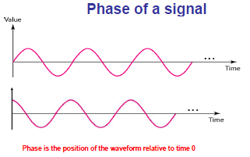

Slide 29
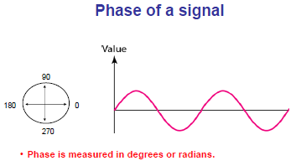
Phase shift of 360 degrees – shift of one complete period

Slide 30
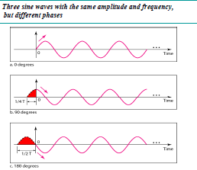

Slide 31
Wavelength
The wavelength is the distance a simple signal can travel in one period.
Wavelength binds the period or the frequency of a simple sine wave to the propagation speed of the medium.
Wavelength = propagation speed x period = propagation speed/frequency

Slide 32
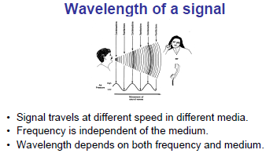

Slide 33
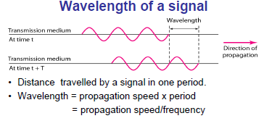

Slide 34
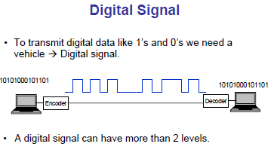

Slide 35
Bit rate
Is the number of bits sent in 1 second
Is expressed in bits per second (bps)
It is also known as channel capacity

Slide 36
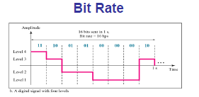

Slide 37
Baud rate
Baud rate is the signal rate
Is the number of signal elements sent in 1 second
It is not the same as bit rate

Slide 38
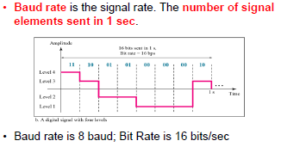

Slide 39
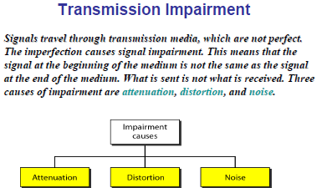

Slide 40
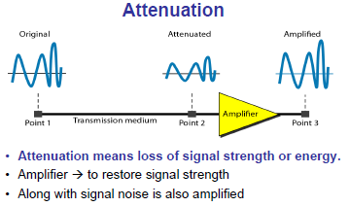

Slide 41
Distortion
Introduced by the transmission system/techniques
Power loss
Higher frequency components are attenuated more resulting in distortion

Slide 42
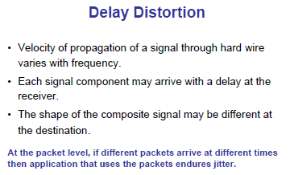

Slide 43
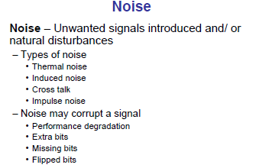

Slide 44
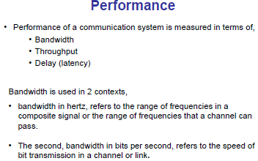

Slide 45
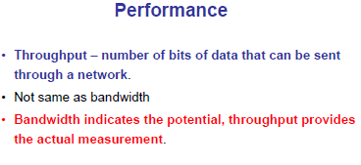

Slide 46
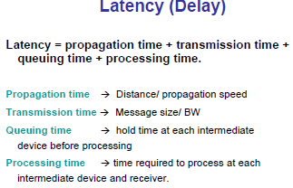

Slide 47
